Slide 1
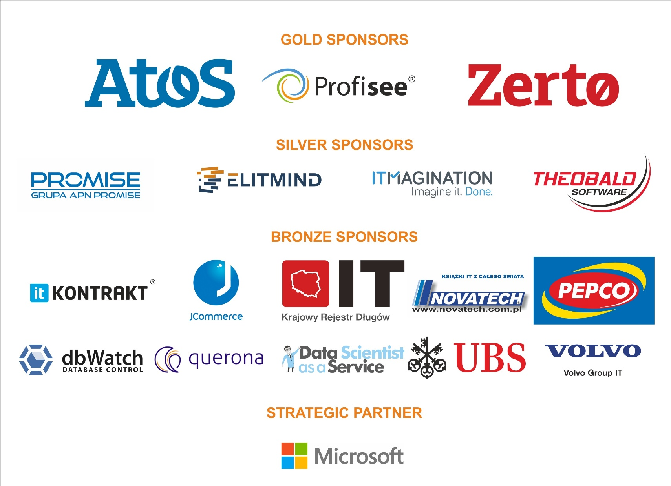

Slide 2
Introduction To Azure Analysis Services
Chris Webb chris@crossjoin.co.uk

Slide 3
Who Am I?
Chris Webb
chris@crossjoin.co.uk
Twitter @Technitrain
UK-based consultant and trainer:
www.crossjoin.co.uk
www.technitrain.com
Author/co-author of several books:
MDX Solutions
Expert Cube Development with SSAS 2008
Analysis Services 2012: The BISM Tabular Model
Power Query for Power BI and Excel
Data Platform MVP
Blogger: http://blog.crossjoin.co.uk

Slide 4
Agenda
What is Azure Analysis Services?
Do we even need Analysis Services any more?
Configuring a new Azure Analysis Services server
Developing with Azure SSAS
Connecting to on-premises data sources
Automation
Pricing
Monitoring
What’s definitely planned and what may be coming
Why use Azure Analysis Services?

Slide 5
What is Azure Analysis Services?
A Platform as a Service version of SSAS
Specifically, SSAS Tabular models at 1400 compatibility level
That’s the same level as SSAS 2017 Tabular
All SSAS Tabular modelling features supported
Feature split across Basic/Standard tiers is roughly equivalent to Standard Edition/Enterprise Edition on-premises
Reached GA in April 2017

Slide 6
Do We Even Need Analysis Services?
Analysis Services is not just about making your queries go faster – after all, we now have lots of other great scale-out/up options
Though it is still hard to beat at doing complex calculations quickly
The important thing it that it is a semantic layer:
Model your data once and share it with your users
Users can create queries by dragging and dropping in many different client tools – no need to write SQL
Power BI is a self-service BI tool, not a replacement for Analysis Services
Remember that Analysis Services is the engine behind the Power BI and Excel (Power Pivot) Data Models
Do your users want to build their own models? Can they?

Slide 7
Configuring Azure Analysis Services
Only available in some regions
You will need:
An Azure subscription (obviously)
A Resource Group
Azure Active Directory – no other way to connect to Azure SSAS
A user in Azure AD that you can set as an SSAS Administrator
The latest version of SSDT/Visual Studio and SSMS installed locally
The Azure SSAS version of the On-Premises Gateway installed if you want to load data from on-premises data sources
Then go to the Azure Portal and follow the instructions…

Slide 8
Developing With Azure SSAS
Create a 1400 compatibility level SSAS Tabular project in SSDT
Connect to your data sources – use Service Account for data source impersonation mode
Build your model as normal
Enter your SSAS instance name in the Deployment Server property
Deploy (sign in as an SSAS administrator when the Azure AD popup appears, if necessary)
Process as normal
Build reports in Power BI and Excel as normal

Slide 9
Connecting To On-Premises Data Sources
If your data sources are on-premises, you need to install the On-Premises Data Gateway
Eventually this will be the same version as used by Power BI and Flow, but right now it’s a separate version and cannot be installed on the same machine
On-premises data sources supported right now:
SQL Server
APS
Oracle
Teradata

Slide 10
Automation
Azure Analysis Services REST API can be used for admin tasks
At present, the Azure Portal can generate code for creation of Azure SSAS servers in:
Azure CLI
PowerShell
C#
Ruby
Much faster than provisioning SSAS on a VM in Azure or elsewhere
Existing SSAS PowerShell Cmdlets can be used for processing

Slide 11
Pricing And Tiers
Three tiers:
Developer: Lowest spec, intended only for development but not limited to that by licence, although no SLA
Basic: No DirectQuery, no perspectives, limited to one partition per table
Standard: All features available
Tiers are divided up into pricing levels
Dev/Test offer “coming soon”
50% discount on rates in place until June 1st 2017

Slide 12
Pricing Levels By Tier
Pricing for Western Europe in USD:
Tier | QPUs | Storage | Approx. Cost/Month
Developer | 20 | 3GB | $98.21
B1 | 40 | 10GB | $319.92
B2 | 80 | 20GB | $639.84
S0 | 40 | 10GB | $900.24
S1 | 100 | 25GB | $1510.32
S2 | 200 | 50GB | $3020.64
S4 | 400 | 100GB | $6033.84

Slide 13
Important Points About Pricing
You can move up/down pricing levels on demand with some restrictions:
You can always move up a tier
You can always move up/down pricing levels within a tier
You cannot move down a tier, eg from Standard to Basic or from Basic to Developer
You can pause servers – and paused servers cost nothing
This moving up/down pricing levels and pause/resume can be scripted and scheduled
Therefore the monthly costs on the previous slide are probably not what you would pay in real life!

Slide 14
What Is A QPU?
QPU = Query Processing Unit
A QPU is a relative unit of computing power for querying and processing
A server with 200 QPUs will be 2x faster than one with 100 QPUs
100 QPUs is roughly equal to 5 pretty fast cores

Slide 15
How Much Memory Do You Need?
How big is your model? Not easy to determine until you deploy
How much will your model grow over time?
Lots of well-known tricks for reducing SSAS Tabular memory usage
A full process may mean memory usage doubles/triples – but do you need to do a full process?
Processing individual partitions/tables will use less memory
Some unoptimized queries/calculations may result in large memory spikes

Slide 16
Monitoring
Activity log records events such as creation/pause/deletion of servers
Metrics shows activity on the server over time, for example:
Memory used
QPUs used
DMVs can also be used to monitor memory and activity but may not be 100% accurate (though close enough)
Extended Events also work, though you can’t write the output to a file

Slide 17
Azure SSAS Planned/Possible Features
Some way of moving a model from Power BI to Azure SSAS (and updating reports) is a must-have - and something is planned
Will be possible to scale-out over multiple servers and spread user queries across them evenly
Vote/suggest in the Azure SSAS feedback forum!
Ideas “under review” include:
Multidimensional models (by far the most popular)
Support for processing (manual and automated) via the portal
Geo-redundancy
Azure Elastic Pools for SSAS

Slide 18
Why Use Azure SSAS? The cloud arguments
Because you’re moving everything to the cloud
Because your data is already in the cloud
No upfront infrastructure costs
Lower maintenance/administration costs
Immediate access to new engine features (as we have with Power BI today)
Cheaper, more reliable and secure than your own server?

Slide 19
Why Use Azure SSAS? Scale Up/Out
Most SSAS workloads vary by time
Weekdays are much busier than weekends
Daytime is much busier than night
Some days, such as month-ends, are much busier than others
Why buy lots of expensive hardware that is idle most of the time?
With Azure SSAS you will be able to only pay for resources when you actually need them
Pause servers when they aren’t needed
Quickly add new servers to cope with high demand

Slide 20
Why Use Azure SSAS? Power BI Grow-Up
Power BI has no dedicated capacity, Azure SSAS has – so more reliable query/processing performance
Power BI models have a maximum size of 1GB – Azure SSAS models can be much larger
A single Power BI user’s models cannot exceed 10GB overall – Azure SSAS can use as much memory as you can pay for
Full control over when and how often you process
Partitioning means you only have to process the parts of your model where data has changed – so it can be much faster
Cheaper and more flexible that Power BI Premium?

Slide 21
Why Use Azure SSAS? DirectQuery Limitations
Power BI DirectQuery mode is the alternative to using Azure SSAS
It’s certainly cheaper than paying for Azure SSAS, but…
For data volumes that will fit into SSAS, you will get better query performance with SSAS
DirectQuery still has limitations, eg with DAX calculations and data sources supported
Note: Azure SSAS supports DirectQuery too

Slide 22
Why Use Azure SSAS? Power BI ALM
Azure Analysis Services allows for one central model instead of multiple, potentially duplicated/inconsistent models
Azure SSAS models can be stored in source control via Visual Studio/SSDT – Power BI models cannot
Still, not a solution for putting Power BI reports in source control
BISM Normalizer is now open source and works with Azure SSAS
Automation options seen earlier allow for automated creation of servers, deployment, processing
Much richer monitoring and logging capabilities

Slide 23
Why Use Azure SSAS? ISVs and B2B
Many ISVs today install SSAS as part of packaged solutions – now these solutions can be moved to the cloud
Solves several problems:
Customers often install on substandard/old hardware and OS
Customers only want to pay for Standard Edition
What version of SSAS do your customers have installed?
Who administers the solution? Customers often can’t/won’t
If ISV administers, how can they connect to do so?
Similarly, companies that sell data can use Azure SSAS to give access to pre-built models over the internet

Slide 24
Links
https://azure.microsoft.com/en-us/documentation/articles/analysis-services-overview/
https://azure.microsoft.com/en-us/pricing/details/analysis-services/
https://azure.microsoft.com/en-in/blog/introducing-azure-analysis-services-preview/
https://feedback.azure.com/forums/556165
https://blog.crossjoin.co.uk/2016/10/25/first-thoughts-on-azure-analysis-services/#comments
http://www.kasperonbi.com/analysis-services-in-azure-when-and-why/
https://ruiromanoblog.wordpress.com/2016/12/03/automate-azure-analysis-services-pauseresume-using-powershell/
https://github.com/Microsoft/Analysis-Services

